Slide 1
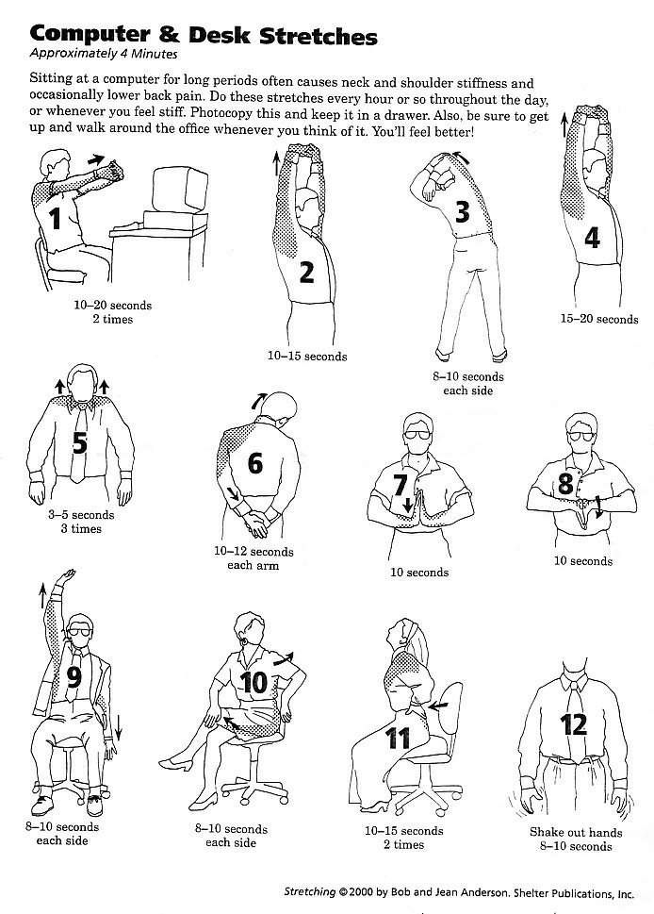
Computer & desk stretches

Slide 4
3-left side

Slide 5
3-right side

Slide 6
4

Slide 7
5-1

Slide 8
5-2

Slide 9
5-3

Slide 10
6-right arm & hand

Slide 11
6-left arm & hand

Slide 12
7

Slide 13
8

Slide 14
9-right up & left down

Slide 15
9-right down & left up

Slide 16
10-left arm & leg

Slide 17
10-right arm & leg

Slide 18
11-1

Slide 19
12

Slide 20
13

Slide 21
14

Slide 22
15

Slide 23
16

Slide 24
17

Slide 25
18

Slide 26
19

Slide 27
20

Slide 28
21

Slide 29
22

Slide 30
23

Slide 31
24

Slide 32
25

Slide 33
26

Slide 34
27

Slide 35
28

Slide 36
29

